Slide 1
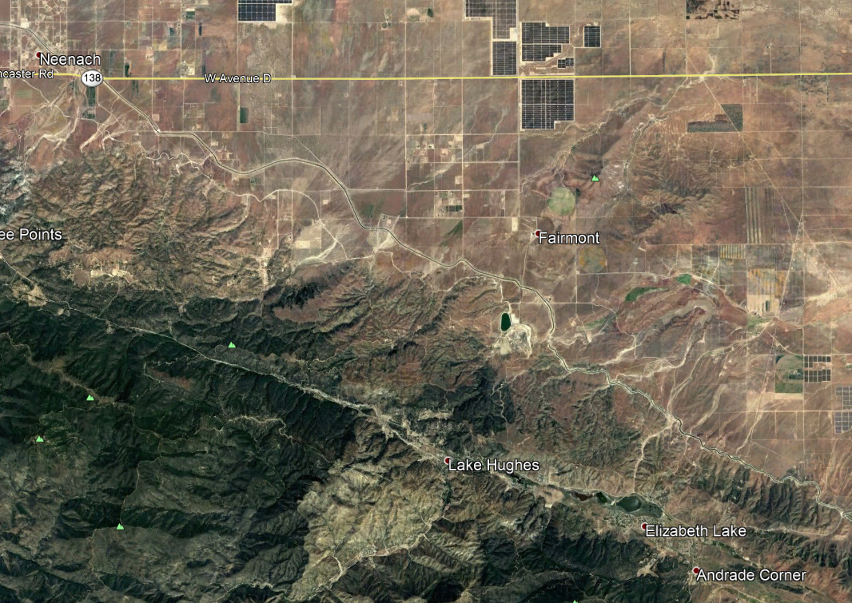

Los Angeles Department of Water and Power
Fairmont Arsenic Sedimentation Plant Project Introduction

Slide 2
Outline
Introductions (and why to pay attention to Monroe)
Project background
Key project details
Common water treatment project delivery mechanisms
Suggestions for:
Developing a team structure
Determining interim and final deliverables

Slide 3
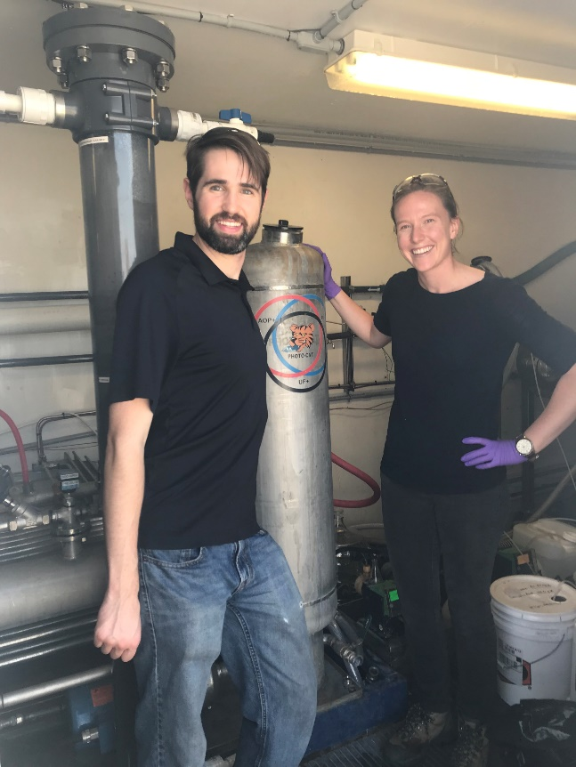
Introductions
Introductions
Tori Klug, P.E.
Former AguaClara Design Team Lead and overall Team Lead
Worked on early versions of the AguaClara plant design tool
Michael (Mickey) Adelman, P.E.
Former AguaClara grad student
Worked on the first StaRS Filter along with plate settler research
Treatment process engineers at Stantec (formerly MWH), in the “AguaClara West” office (aka Pasadena, CA).

Slide 4
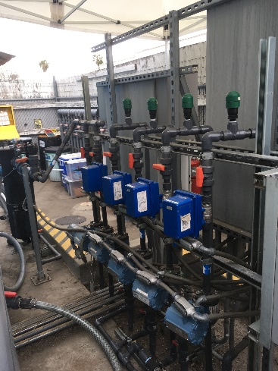
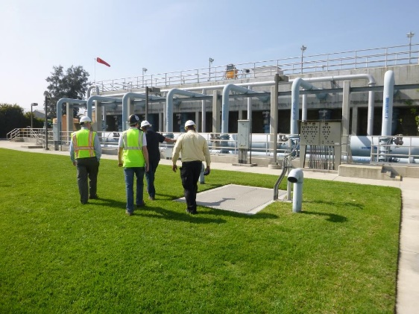
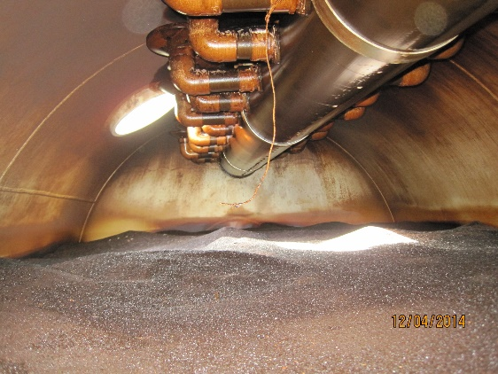
Why to Pay Attention to Monroe
Introductions
Environmental engineering myths are real (and prevalent)!
“Don’t you need really small filter media to remove really small particles?”
Chlorine works – but only if you’ve also removed the suspended solids!
Plant hydraulics are really important!
You might have a facility that can’t run – or even destroy some equipment! – if you aren’t paying attention to how water flows through the plant.
Beware of closed processes that don’t give feedback – you never know what’s going on inside.

Slide 5
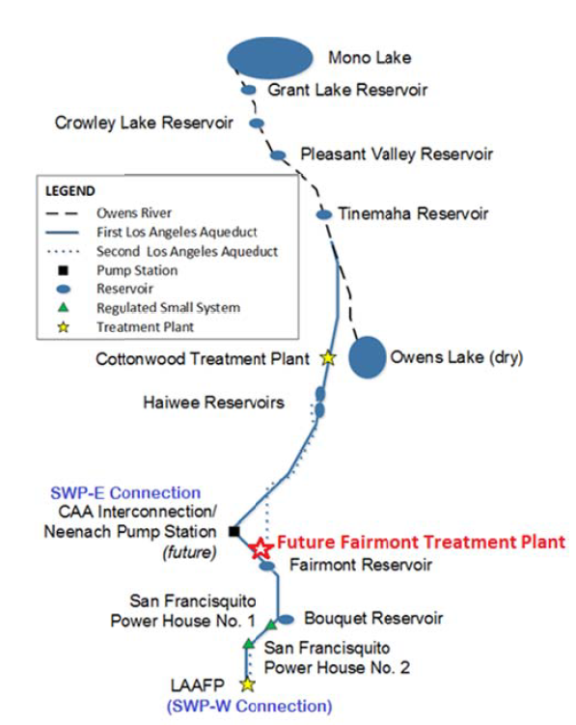
Project Objectives
Project Background
From the Owner’s Engineer (OE) Scope of Work (SOW):
Improve operational flexibility of the Los Angeles Aqueduct Filtration Plant (LAAFP) by improving source water quality.
Prevent additional arsenic laden sediment accumulation in the North Haiwee Reservoir by eliminating the need to operate the Cottonwood Treatment Plant.

Slide 6
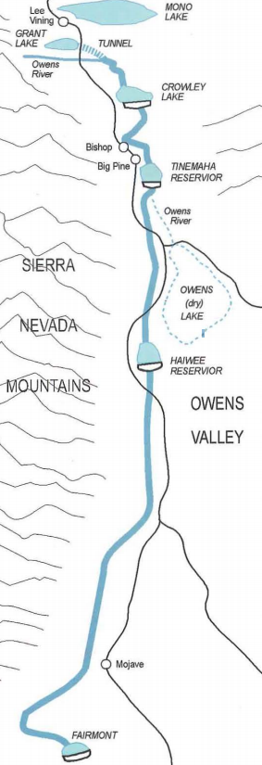
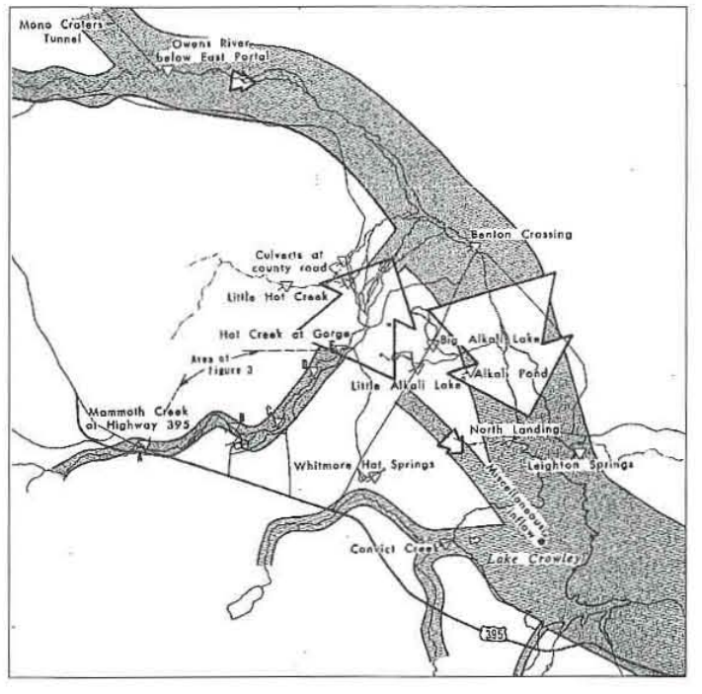
Arsenic Source
Project Background
In the Eastern Sierras, geothermal input of arsenic at Hot Creek Gorge
http://calteches.library.caltech.edu/3925/1/Arsenic.pdf

Slide 7
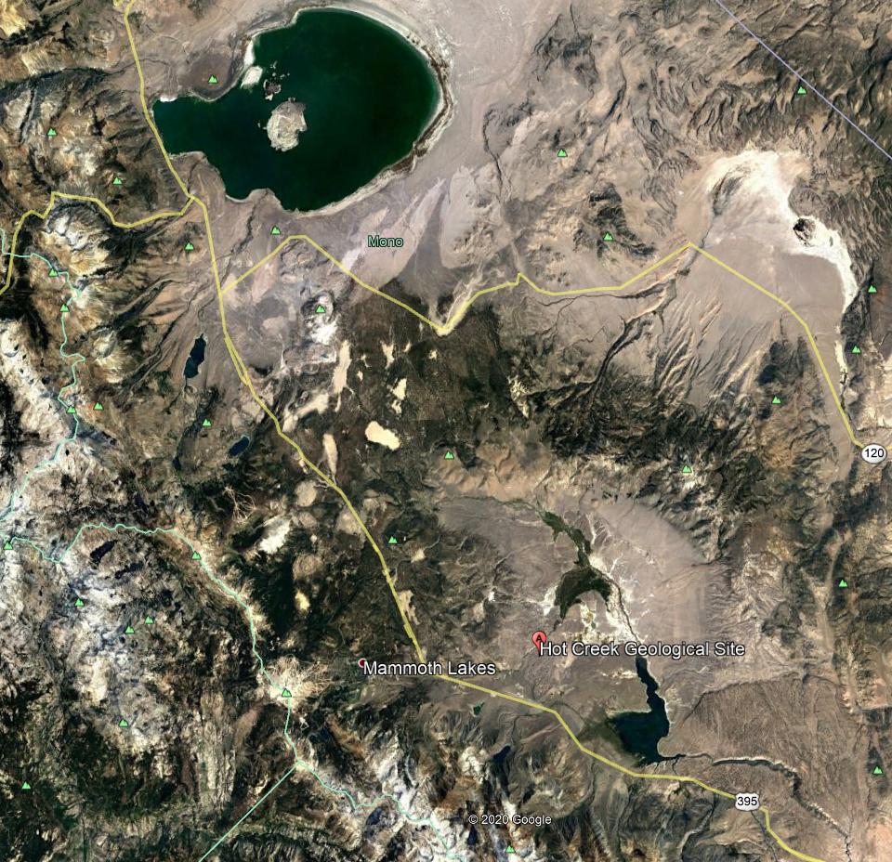
Project Background

Slide 8
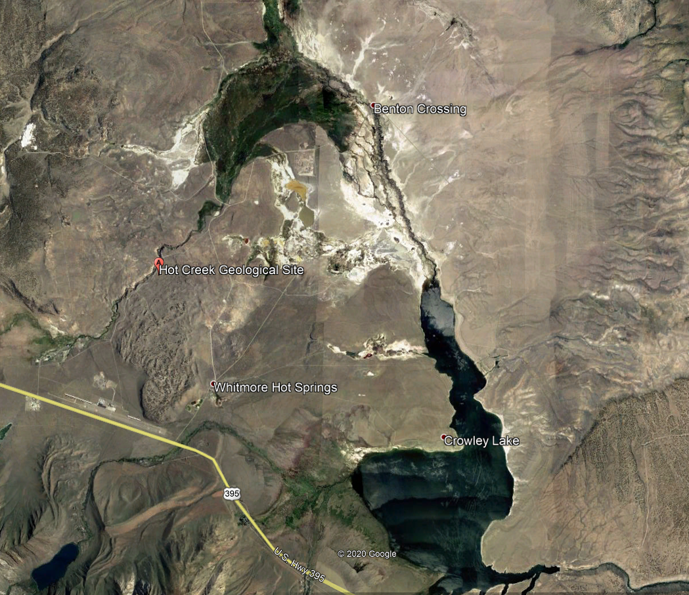
Project Background

Slide 9
Project Context
Project Background
Cottonwood Treatment Plant
Pretreatment with coagulant (FeCl₃)
Settling in the North Haiwee Reservoir
Los Angeles Aqueduct Filtration Plant (LAAFP)
Ozonation → biologically-active media filtration
UV disinfection followed by chloramination
LAAFP has struggled with significant turbidity spikes and is not well suited for high-turbidity influent

Slide 10
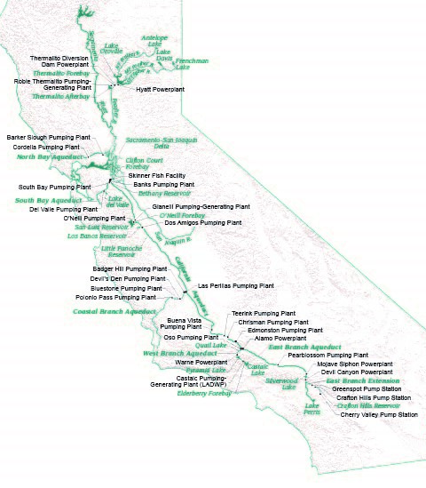
Project Context
Project Background
State Water Project East Branch (SWP-E) will also bring water into the future Fairmont Treatment Plant
SWP-E will have turbidity values above the LAAFP’s treatment capabilities
More info on the SWP California Aqueduct and its branches on the CA Department of Water Resources (DWR) website: https://water.ca.gov/Programs/State-Water-Project/SWP-Facilities

Slide 11
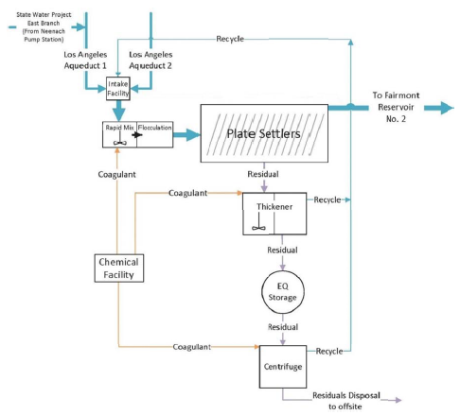
Process Flow Diagram (from OE SOW)
Key Project Details

Slide 12
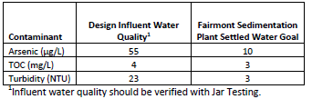
Key Design Criteria (from OE SOW)
Key Project Details
Plant Capacity:
Design flow rate – 480 MGD
Average flow rate – 240 MGD
Minimum flow rate – 60 MGD
Treatment Goals:
Plate settler hydraulic loading rate: 0.5 gpm/sf

Slide 13
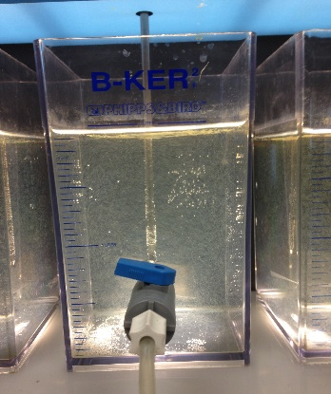
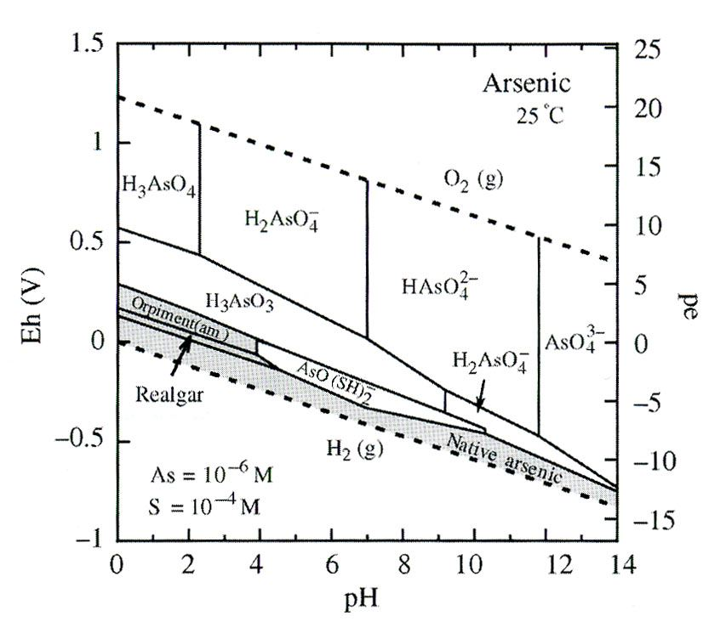
Coagulation/Flocculation: Treating Turbidity and Arsenic
Key Project Details
Ferric chloride addition plays two key roles in this design:
Coagulation and flocculation for bulk suspended solids / turbidity removal.
Removal of arsenic by adsorption and co-precipitation.
Which function will govern dosing such that a single dose is adequate for both functions?
What is the potential range of doses? What is the recommended strategy for the operators to adjust dosing?

Slide 14
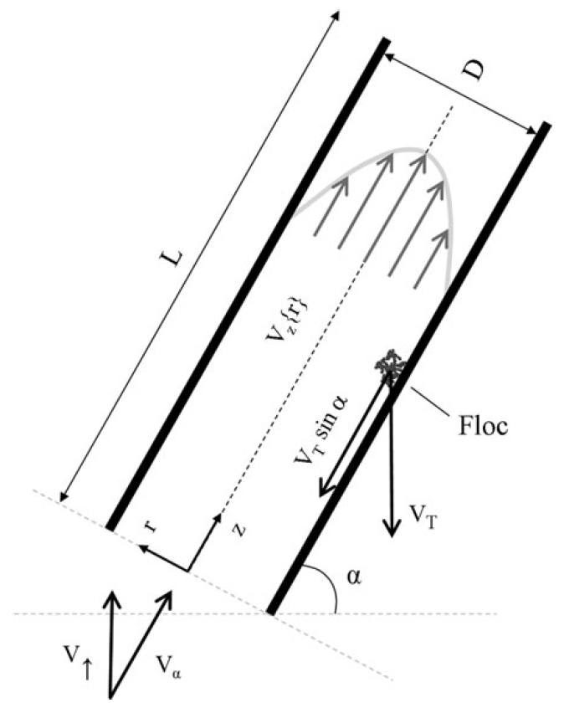
Sedimentation: Optimizing Plate Settler Geometry
Key Project Details
Optimizing plate settler design to achieve desired capture velocity with a reasonable tank geometry.
Remember, plate settler hydraulic loading rate was set in the Scope of Work as 0.5 gpm/sf …
Design could vary:
Plate length (sets tank depth)
Plate upflow velocity and number of plates (sets tank area)
Plate spacing (must be wide enough to avoid floc rollup)
Adelman et al. 2013

Slide 15
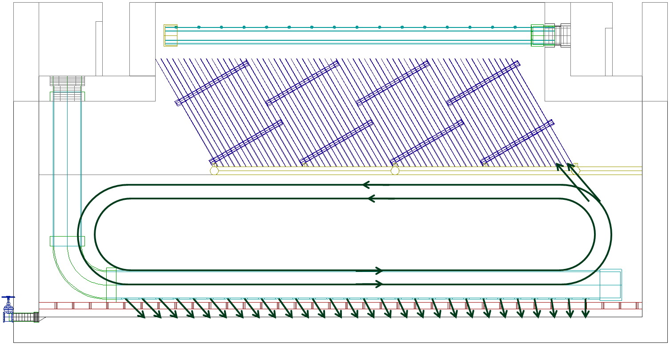
Plant Hydraulics: Distributing a Wide Range of Flows
Key Project Details
Flow rate may range from 60 to 480 MGD (!)
The plant hydraulics need to solve multiple flow distribution problems:
Between trains of floc/sed basins
Within each sed basin
Also critical to maintain high enough velocity but low enough energy dissipation rate between flocculator and sedimentation tank.
It’s possible that the only solution is to take trains offline at lower flows!

Slide 16
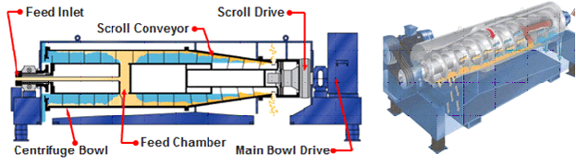
Solids Disposal
Key Project Details
From SOW – average flow of 320 cfs, average turbidity of 14 NTU → ~144 wet tons/day of processed residuals for off-site disposal. Refining mass balance is important!
Centrifuges as preferred active dewatering technology
Solid residuals must be disposed of as Hazardous Waste per CA guidelines
Alternative sludge handling methods were evaluated during planning but weren’t included in SOW because of cost and schedule risks
Class could explore innovative ways to reduce sludge volume and minimize sludge handling costs…
http://www.hiller-us.com/sludge-dewatering.php

Slide 17
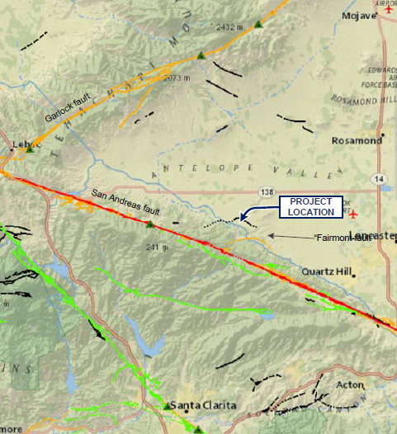
Seismic Concerns
Key Project Details
Proximity to San Andreas Fault means that structural and geotechnical engineers’ expertise will be vital
How could the treatment system design accommodate the likelihood of significant seismic events?

Slide 18
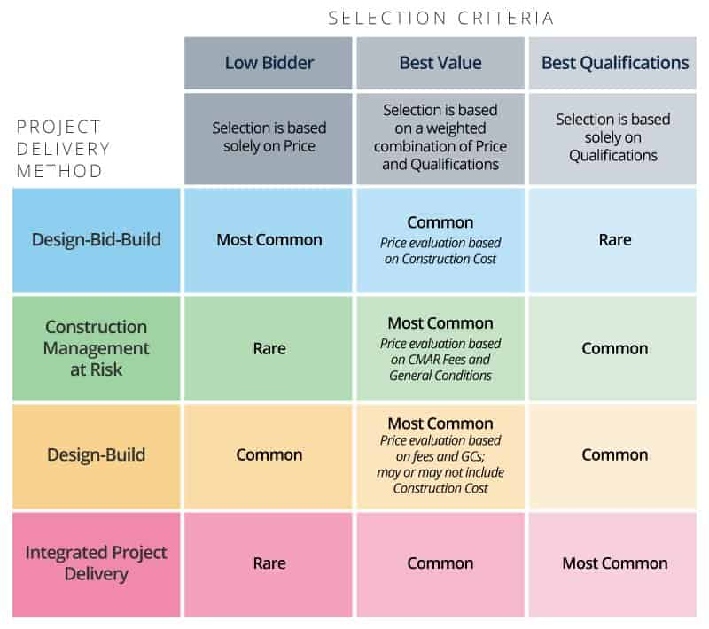
Project Delivery Methods
Project Delivery Methods
https://www.smartsheet.com/construction-bidding

Slide 19
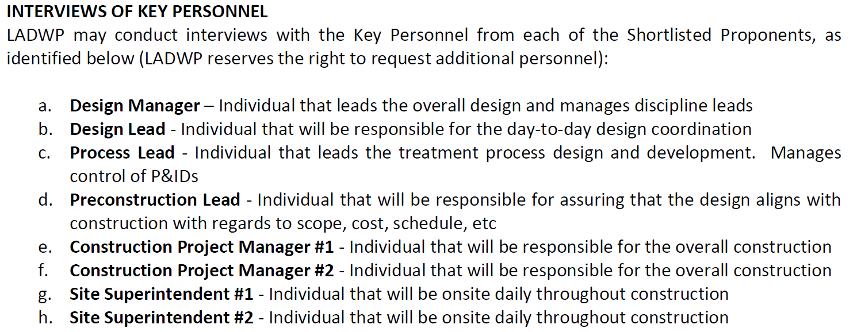
Key Roles for Projects like Fairmont
Project Delivery Methods

Slide 20
How we might approach this design
Suggestions
Process Lead
Design Lead
Rapid Mix/Floc Team
Chemicals Team
Hydraulics Team
Sludge Disposal Team
Sedimentation Team
Other Disciplines
Notes:
Process lead would coordinate and guide the process teams; Design Lead would coordinate between Process Teams and other disciplines.

Slide 21
How we might approach this design
Suggestions
Sedimentation Team
Rapid Mix/Floc Team
Chemicals Team
Sludge Disposal
Team

Slide 22
Process Teams’ Responsibilities
Suggestions
Developing calculations to support setting the design criteria
Coordinating with vendors relevant to their portion of the plant
Communicating with other teams about relevant design changes
Working with CAD drafters to develop relevant portions of construction drawings
Developing relevant portions of the BODR
Developing materials to communicate key parts of their design to the client during regular client design meetings
Each process team would carry their portion of the design from project kickoff to project completion

Slide 23
Process Lead and Design Lead Responsibilities
Suggestions
Process Lead would coordinate between the different process teams
Organize and facilitate process team meetings
Make sure that team updates that impact other parts of the design are communicated effectively
Review deliverable drafts from process teams and provide feedback
Design Lead would coordinate between the Process Team and other disciplines
Organize and facilitate meetings (and general flow of information) between Process Team and:
Civil
Structural
Instrumentation & Control (I&C)
Mechanical
Architectural
Landscape
Coordinate between teams to develop BODR, drawings, specifications, etc.
Notes:
Some key questions that the design lead might ask throughout the design process:
What do changes in the process design mean for structural design?
Is the chemical storage designed to be compliant with the relevant fire codes? Where is secondary containment required? (Work with architectural)
Are we selecting the right type of valves? Are we placing them in a prudent location? (Work with mechanical)

Slide 24
Deliverables
Suggestions
Process Design Criteria
Water quality (influent and effluent) summary
Schematic diagram (Process Flow Diagram [PFD])
Preliminary hydraulic profile
Basis of Design Report (BODR) and 30% Design
Description and design criteria for each treatment process
Final hydraulic profile
Preliminary site layouts
Supporting calculations and product datasheets
60% Design, 90% Design, 100% Design, and Final Design would come later…
Notes:
A set of piping and instrumentation diagrams (P&IDs) and preliminary specifications would also likely be included in 30% Design, but may be out of scope for the course…

